Slide 1
Opening a Food Delivery Company in Paris
Presentation

Slide 2

Introduction & Business Problem
The city of Paris is an international city with a population of 2,148,271 residents.
The city of Paris is divided into twenty administrative districts, more simply referred to as “arrondissements”.
A local food delivery company with a limited startup budget is about to open in the city. In its early years of creation, the company’s motivation is to partner up with the biggest number of restaurants and supermarkets while offering the top-notch customer service to their clients.
Their business strategy for the next five years is to focus on only two districts- ideally next to each to other- and then expand from there once they become financially ready.
This company wants to know which are the two best districts among the twenty that will maximize their revenue for the first year while minimizing their operating costs.

Slide 3
Data Description
The data about all the districts of Paris was found on this website : https://fr.geneawiki.com/index.php/Liste_des_quartiers_de_Paris
This data was combined with geospatial data from Google Maps.
The location data that will be used in this analysis is the Foursquare data.
We will be using API calls to their server to identify the location of venues that best match the company’s objectives and business plan.

Slide 4
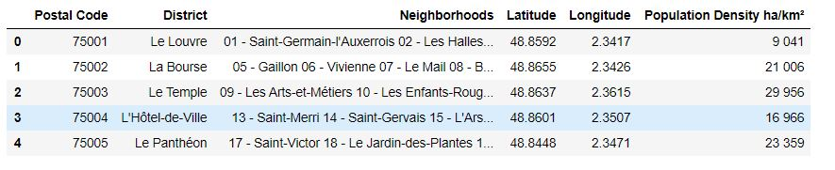
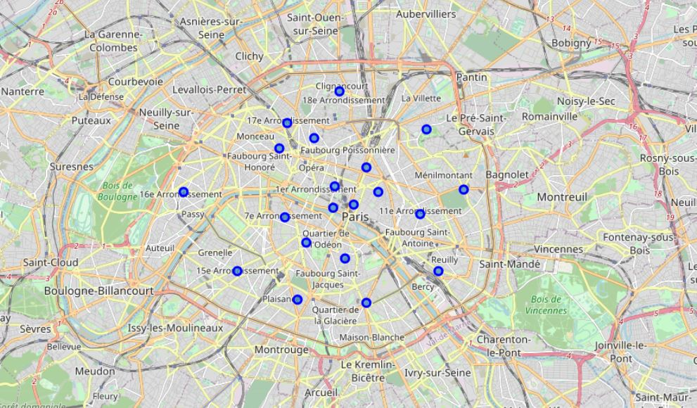
Methodology
Data was cleaned and merged with the Geospatial Data to produce this data frame.
This data frame was used to produce a map describing the locations of all the districts of Paris with the help of the Folium library.

Slide 5
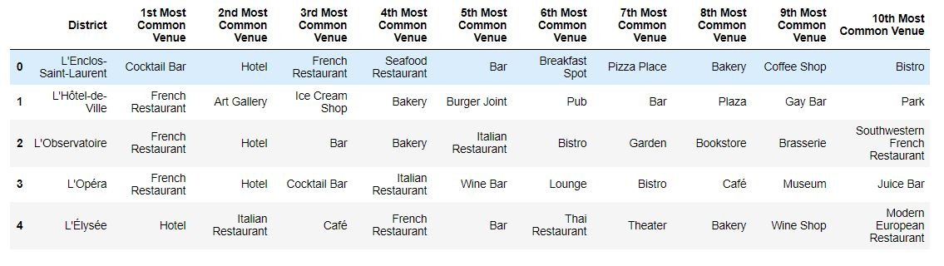
Methodology
At the outset of the API calls to the Foursquare, 937 venues were extracted and 162 unique categories.
The districts are then grouped by taking the mean frequency of occurrence of each category. Using this information, a data frame has been that has the 10 most common venues for each district.
The machine learning algorithm that will be used for this project is Kmeans.

Slide 6
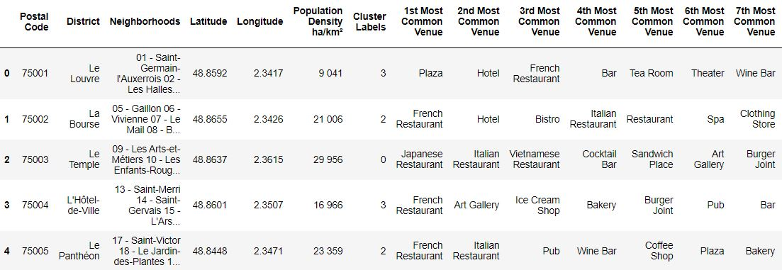
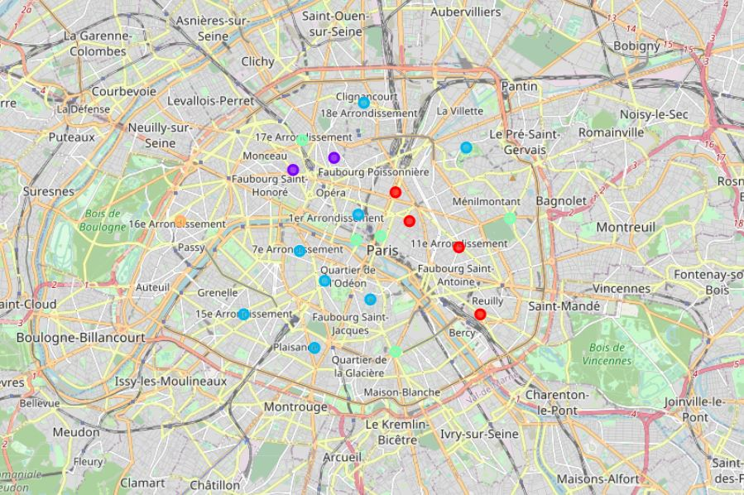
Results
The results of the KMeans analysis were very promising. The algorithm produced 5 clusters labeled from 0 to 4 shown on the map.

Slide 7
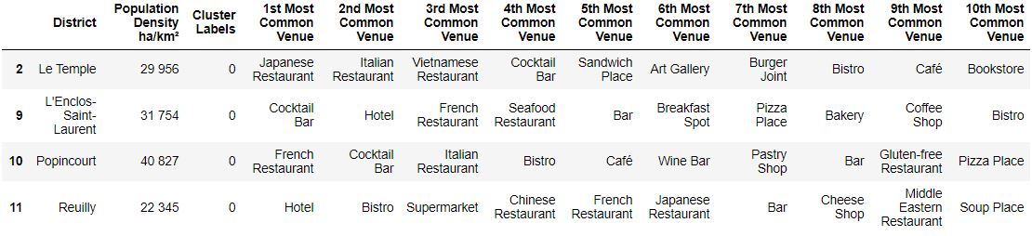
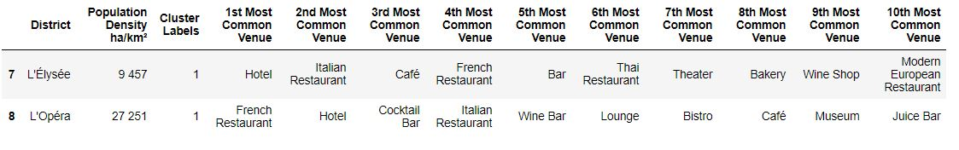
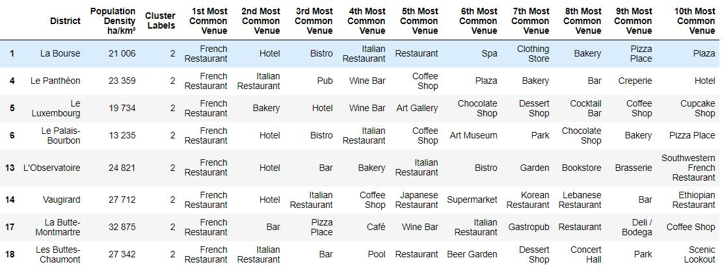
Results

Slide 8
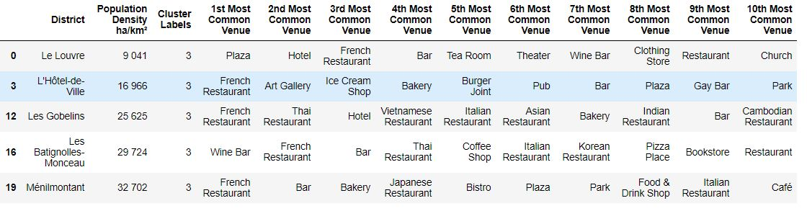
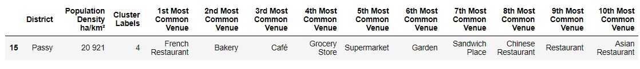
Results

Slide 9
Discussion
It appears that cluster 3 and cluster 4 are the best suited for the company’s needs because they offer the biggest number of business opportunities. French restaurants and hotels are the most common venues in these clusters.
L’Observatoire district with a population density of 24 821 and Vaugirard district with 27 712. These two districts are the best match for the company’s needs, because they have diversified venues, are close to each other and have a great population density.

Slide 10
Conclusion
The goal of the analysis that was done in this report is to determine the two best districts of Paris that have the most upside for our food deliver company. They want to find out which are the districts that offer the best business opportunities. Based on the data collected, and the machine learning approach used (KMeans) it was concluded that, L’Observatoire district and Vaugirard district are the best match for the company.

